Slide 1
Design Presentation: Security
Owner: Sean Norman
CSA07P | 1 of 2
Session Day/Time: |  | Presenters/SMEs:
Virtual Format and Software:
Cohort / Breakout Mgmt
Objective of Session: | As a result of attending this, attendees will better be able to…
Existing Sources: | <link to any supporting content sources (if any)>
Learner Content: | <Link to draft ppt slide deck and any other materials that the attendees would be seeing or using as part of this session>
Presenter/ SME Guide Content: | <Link to any supporting materials that are just for the presenter and/or supporting SMEs>
Required Homework + name of session for HW review: | No homework or pre-required content needed for this session

Slide 2
Design Presentation: Security
Owner: Sean Norman
CSA07P | 2 of 2
Session Flow and Detailed Agenda |  | Presenter/SME: | Time
Prework | No attendee pre-work needed for this session | N/A | N/A
Session Introduction | Set context for when this process takes place | <presenter> | 3 mins
Body of the session / discussion, activities, Q&A... |  | <presenter> | 25 mins
Session Closing / Homework |  | <presenter> | 2 mins

Slide 3
Topics Covered
Security Secure a database in Azure Synapse
Advanced data security
Auditing
Network security
Authentication
Access control
Data protection

Slide 4
Security in Azure Synapse

Slide 5

Agenda
1 Security baseline
Synapse Analytics security baseline for Azure Security Benchmark
2 Network Security
Synapse Managed Virtual Network and Managed private endpoints
3 Auditing
Set up auditing. Analyze audit logs and reports. Production practices

Slide 6
Azure security baseline for Synapse Analytics

Slide 7
The Azure Security Baseline for Synapse Analytics
Contains recommendations that will help you improve the security posture of your deployment
Network security | Protect with VNETs Monitor configuration and traffic of VNETs, subnets and network interfaces Use Advanced Threat Protection (ATP) and DDoS Protection, Record network packets, Use tags for network security groups
Logging and monitoring | Update time synchronization for your compute deployments, Central security log management, Enable auditing on the Azure SQL server-level, Configure security log storage retention, Use advanced Threat Protection (ATP) for Azure SQL Database in conjunction with Azure Security Center to monitor and alert on anomalous activity
Identity and access control
Data protection
Notes:
https://docs.microsoft.com/en-us/azure/synapse-analytics/security-baseline

Slide 8
The Azure Security Baseline for Synapse Analytics
Contains recommendations that will help you improve the security posture of your deployment
Vulnerability management
Inventory and asset management
Secure configuration
Malware defense
Data recovery
Incident response
Penetration tests and red team exercises
Notes:
https://docs.microsoft.com/en-us/azure/synapse-analytics/security-baseline

Slide 9
Network Security in Synapse

Slide 10
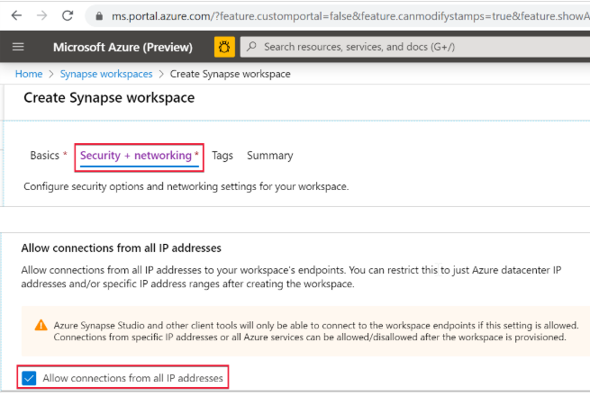
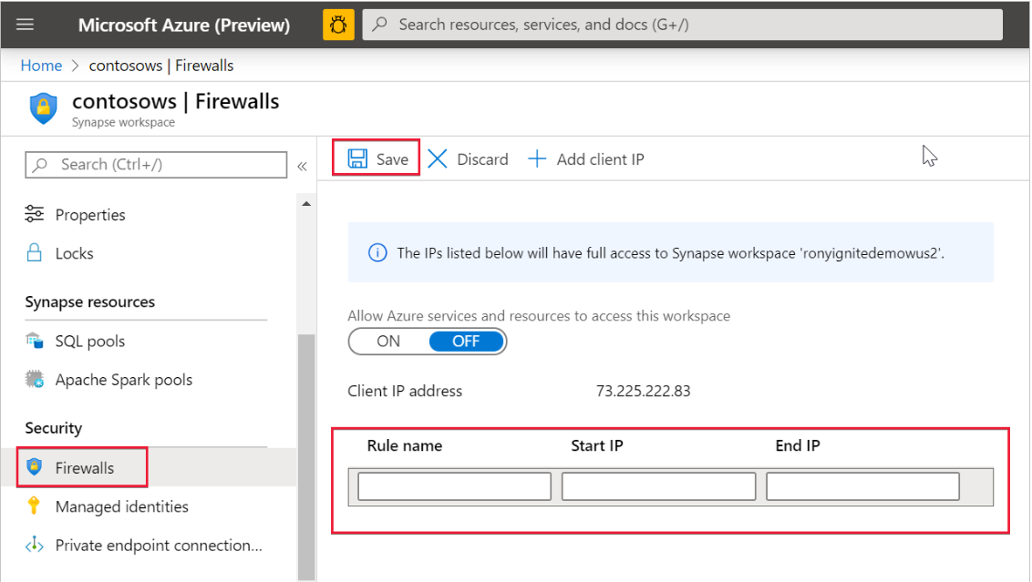
Add Synapse Workspace IP firewall rules
Select Security + networking and check Allow connections from all IP addresses during workspace creation
OR
(after the workspace is created)
Select Firewalls under Security from Azure portal. To add a new IP firewall rule, give it a name, Start IP, and End IP. Select Save when done

Slide 11
Managed workspace Virtual Network - Definition
When you create your Azure Synapse workspace, you can choose to associate it to a Microsoft Azure Virtual Network. The Virtual Network associated with your workspace is managed by Azure Synapse. This Virtual Network is called a Managed workspace Virtual Network.

Slide 12
Managed workspace Virtual Network
Managed workspace Virtual Network provides you value in four ways:
With a Managed workspace Virtual Network you can offload the burden of managing the Virtual Network to Azure Synapse.
You don't have to configure inbound NSG rules on your own Virtual Networks to allow Azure Synapse management traffic to enter your Virtual Network. Misconfiguration of these NSG rules causes service disruption for customers.
You don't need to create a subnet for your Spark clusters based on peak load.
Managed workspace Virtual Network along with Managed private endpoints protects against data exfiltration. You can only create Managed private endpoints in a workspace that has a Managed workspace Virtual Network associated with it.

Slide 13
Create an Azure Synapse workspace with a Managed workspace Virtual Network
First: register the Network resource provider. Registering a resource provider configures your subscription to work with the resource provider. Choose Microsoft.Network from the list of resource providers when you register.

Slide 14
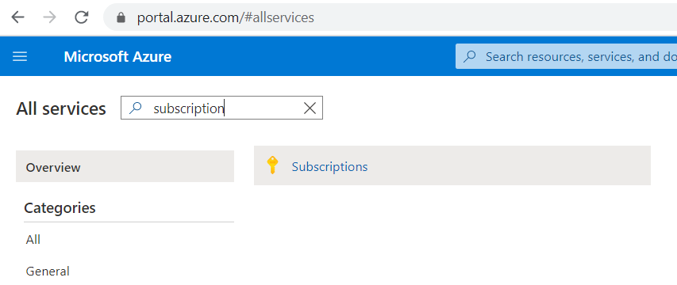
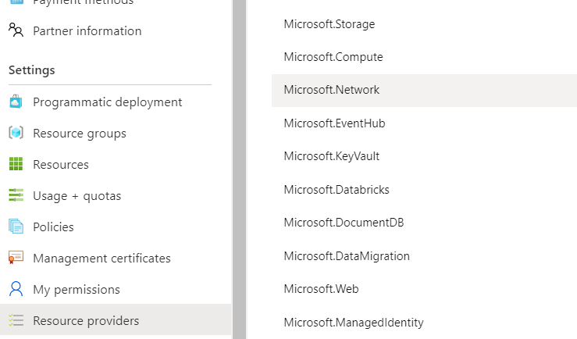
Create an Azure Synapse workspace with a Managed workspace Virtual Network
First: register the Network resource provider.
In the All services box, enter subscription, and then select Subscriptions.
Select Resource providers and view the list of available resource providers. Select Register after selecting the Microsoft.Network resource provider.
Alternatively you can use the Azure Powershell command
> Register-AzResourceProvider -ProviderNamespace Microsoft.Network

Slide 15
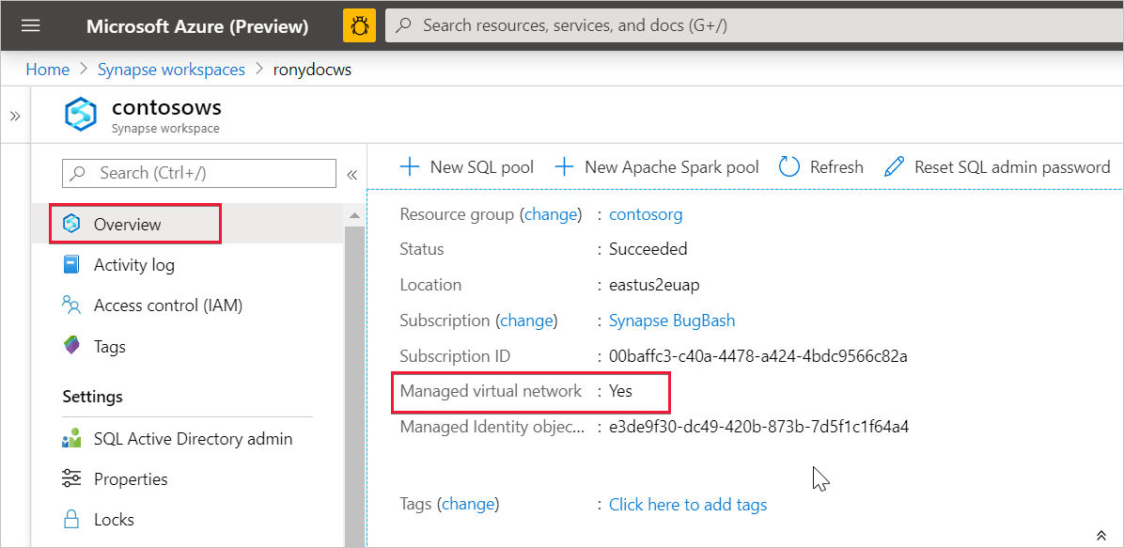
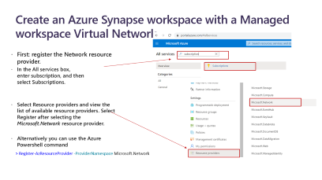

Check the Managed workspace Virtual Network
Check whether your Azure Synapse workspace is associated to a Managed workspace Virtual Network by selecting Overview from Azure portal.

Slide 16
Managed private endpoints - Definition
Managed private endpoints are private endpoints created in the Managed workspace Microsoft Azure Virtual Network establishing a private link to Azure resources. Azure Synapse manages these private endpoints on your behalf.
Only supported in Azure Synapse workspaces with a Managed workspace Virtual Network
Initially created in a “Pending” state in Azure Synapse, initiates an approval workflow, and can be approved/rejected by the Private link resource owner.
Only a Managed private endpoint in an approved state can send traffic to a given private link resource.

Slide 17
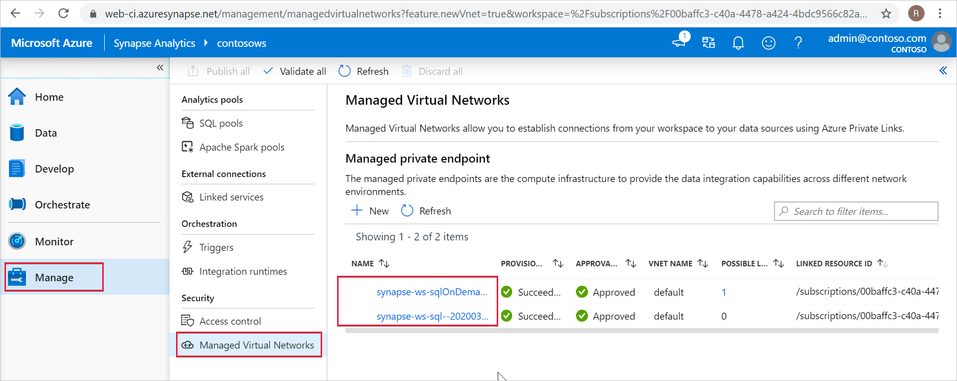
Managed private endpoints for SQL pool and SQL on-demand
When a workspace is created, Azure Synapse automatically creates two Managed private endpoints to SQL pool and SQL on-demand in that workspace.
Select Manage in the left navigation, then select Managed Virtual Networks to see then in the Studio.

Slide 18
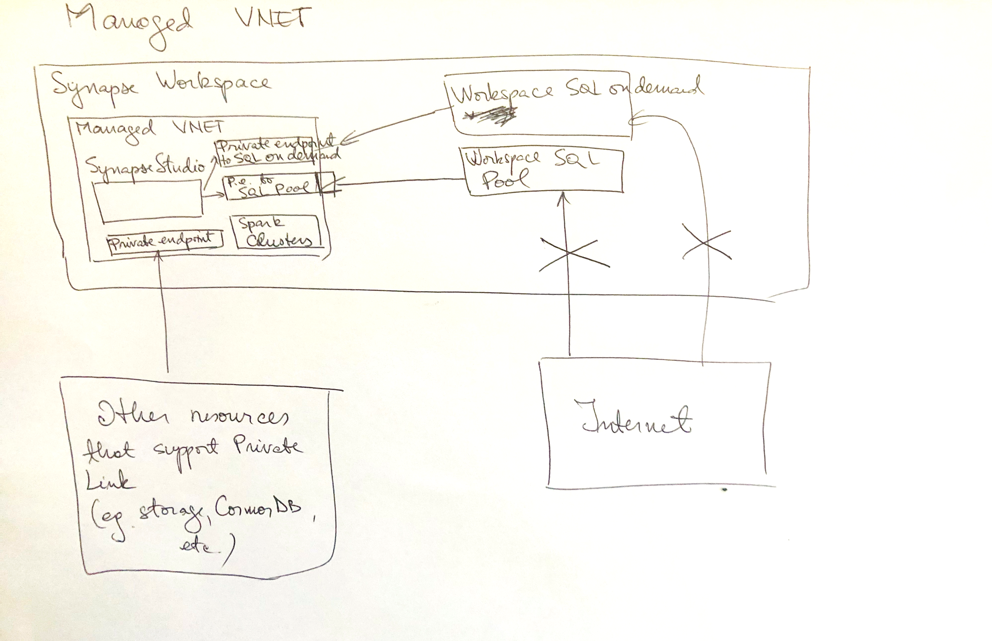

Slide 19
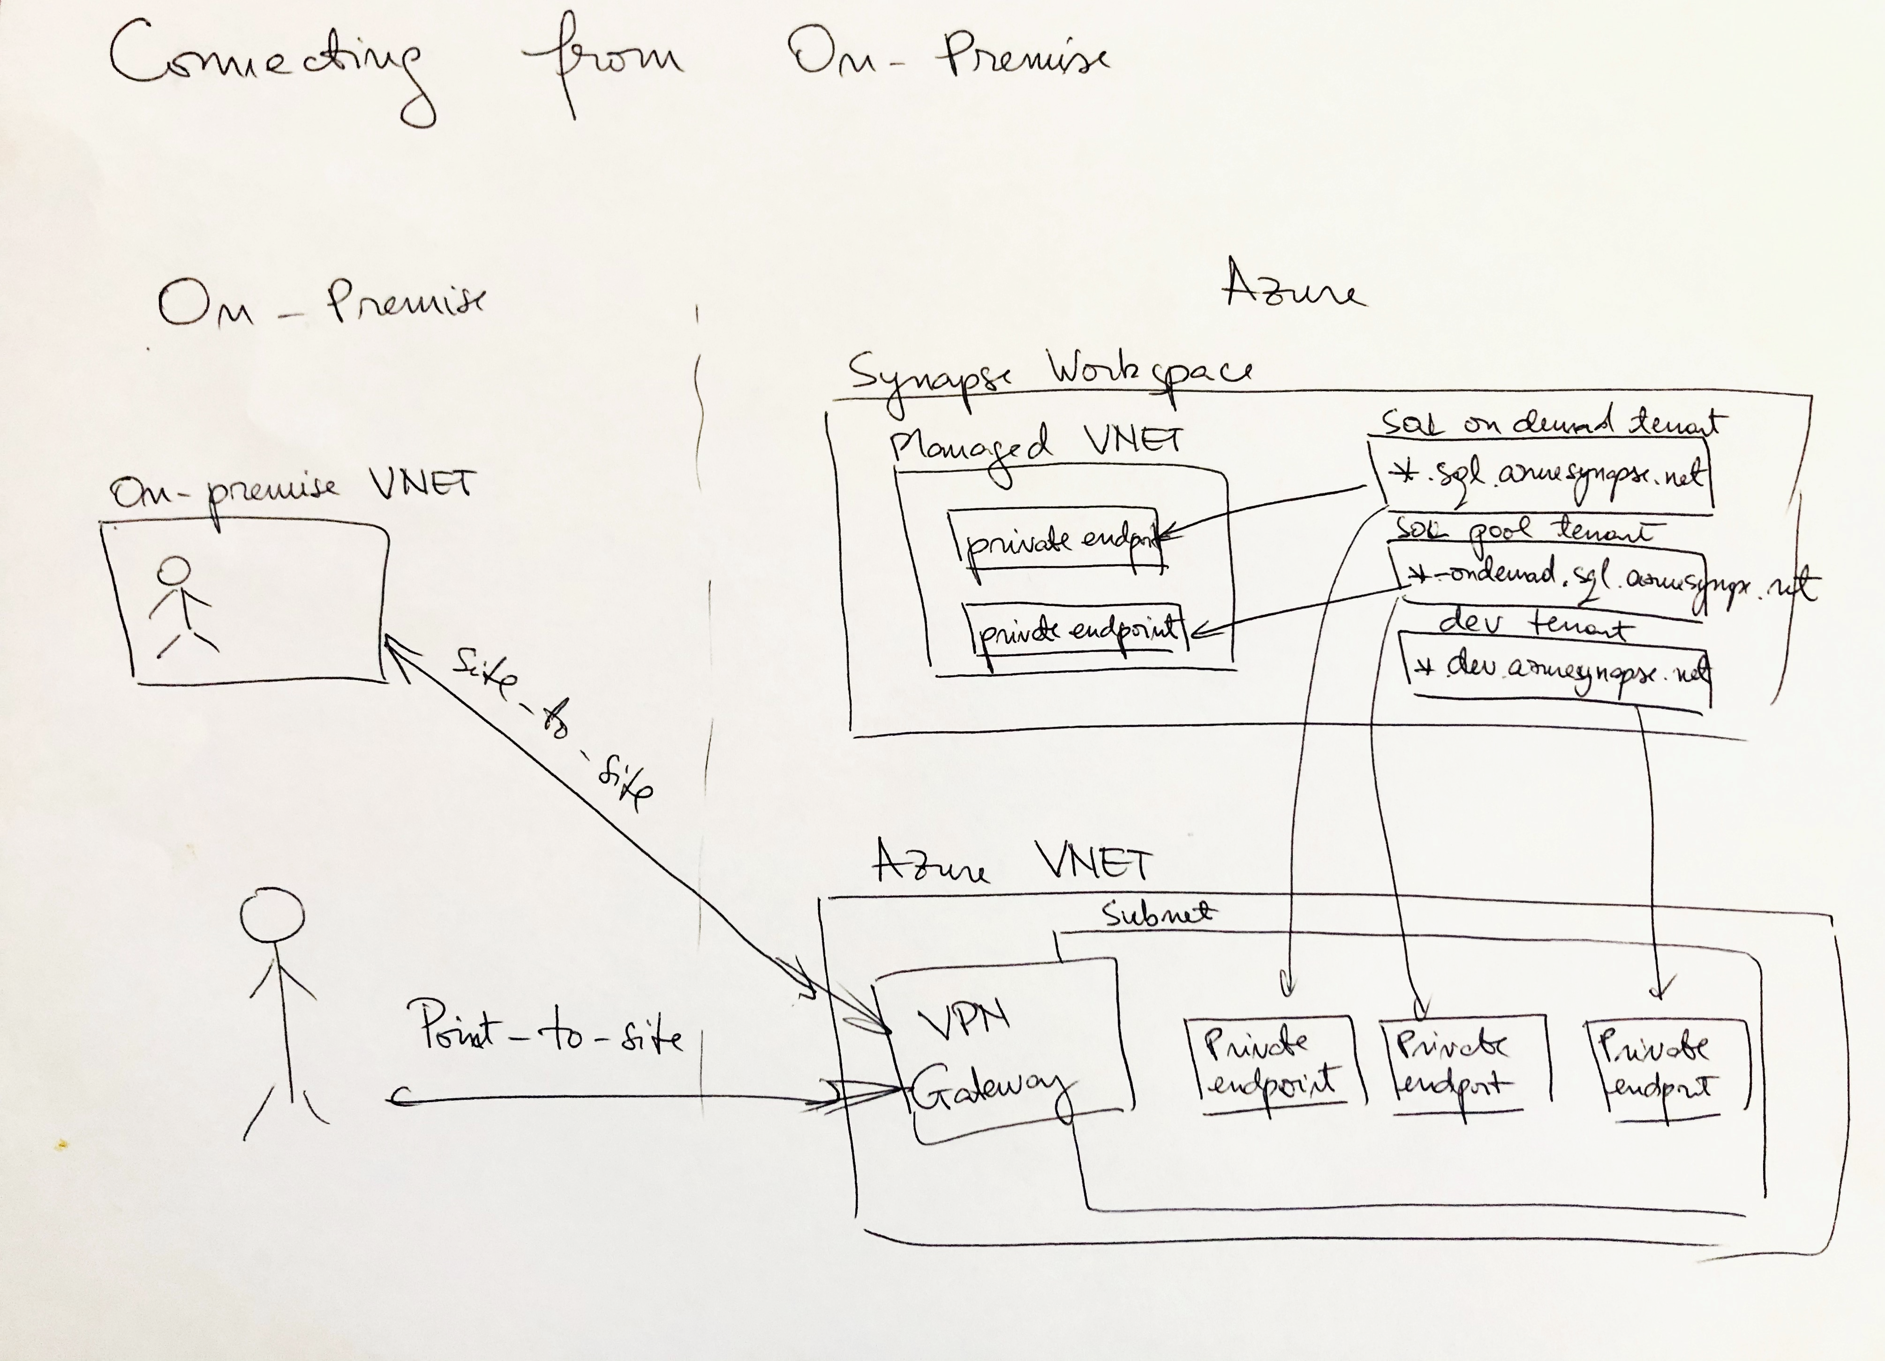

Slide 20
Auditing

Slide 21
Auditing in Azure Synapse Analytics
You can use SQL Database auditing to:
Retain an audit trail of selected events
Report on database activity
Analyze reports
Auditing limitations
Premium storage is currently not supported.
Hierarchical namespace for Azure Data Lake Storage Gen2 storage account is currently not supported.
Enabling auditing on a paused Azure Synapse is not supported. To enable auditing, resume Azure Synapse.
Notes:
Add images

Slide 22
Set up auditing for your server
Audit to storage destination
Audit to Log Analytics destination
Audit to Event Hub destination

Slide 23
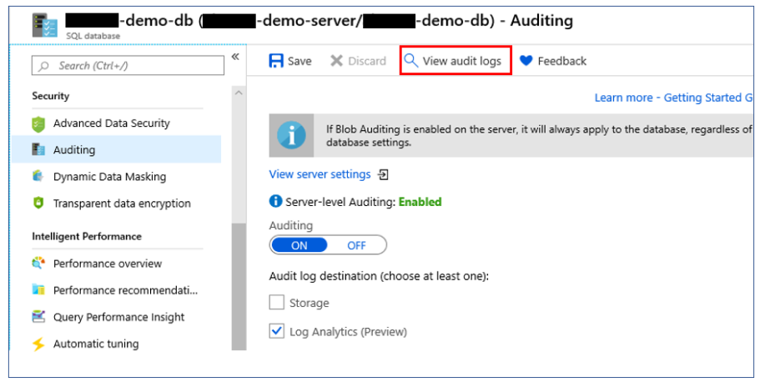
Analyze audit logs and reports

Slide 24
Production practices
Auditing geo-replicated databases
Storage key regeneration

Slide 25
Thank You slide
Thank you

